Slide 1
Bank Loan Case Study
BY-Jayanth Kumar

Slide 2
Project Description
This case study aims to give you an idea of applying EDA in a real business scenario. In this case study, apart from applying the techniques that you have learnt in the EDA module, you will also develop a basic understanding of risk analytics in banking and financial services and understand how data is used to minimize the risk of losing money while lending to customers.
1. Application data
2. Previous application

Slide 3
Approach
Following were the steps of project approach:
1. Observing & understanding the data
2. Data Cleaning
3. Data Analysis
4. Gathering Insights

Slide 4





Tech-Stack Used
Microsoft Excel

Slide 5
Insights and Results

Slide 6

APPLICATION DATA

Slide 7
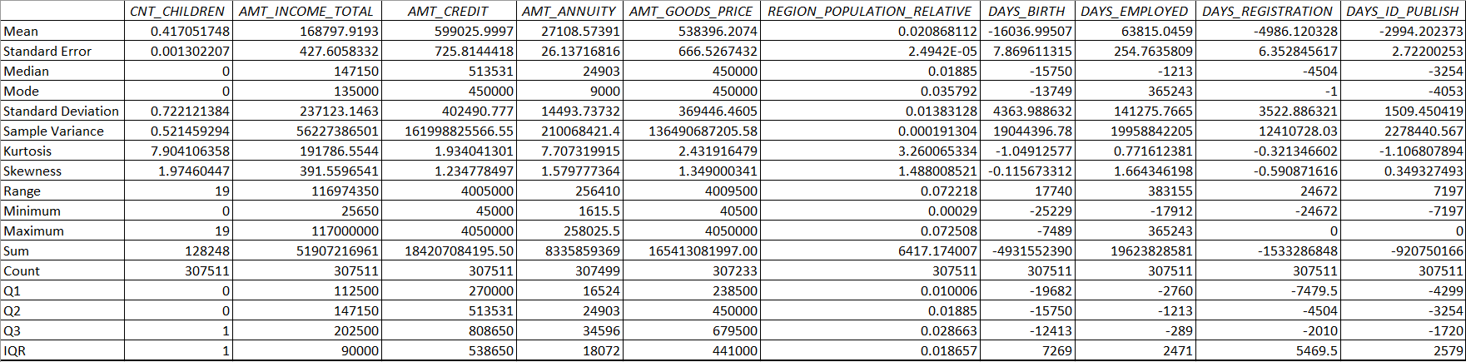
Outliers
Identifying Outliers (After Removing Unnecessary Columns)

Slide 8
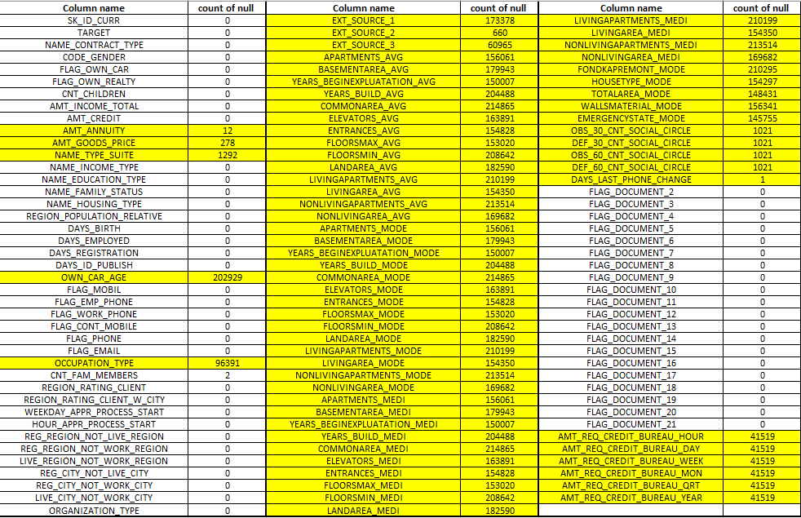
Count of Null value in all column

Slide 9
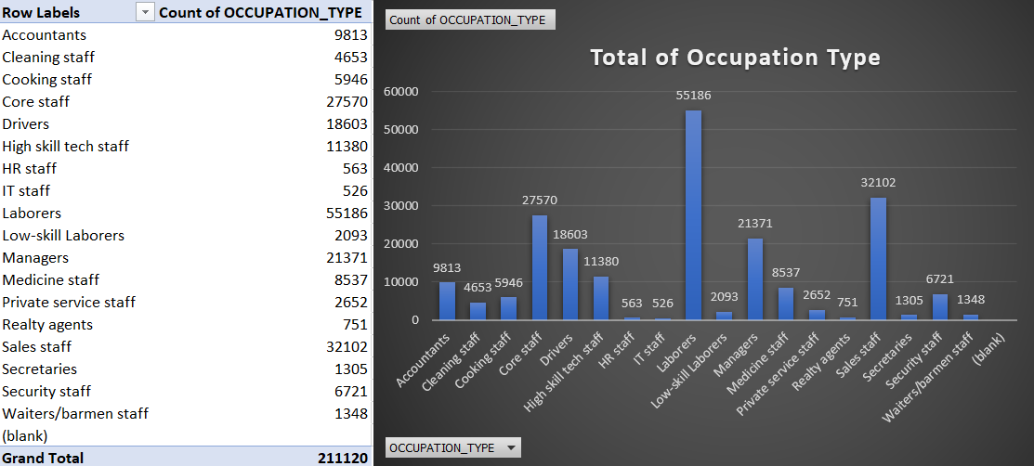

Slide 10
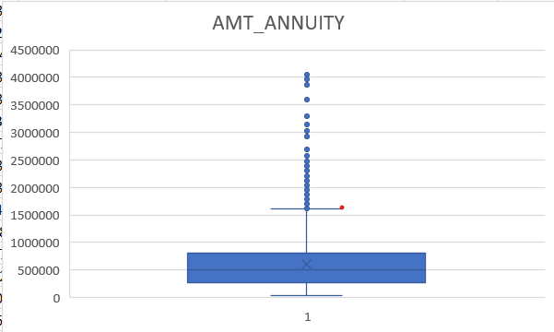
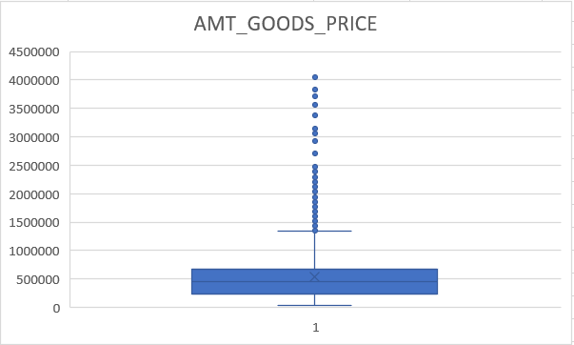
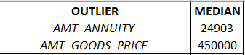
Replacing all the outlier columns with median

Slide 11
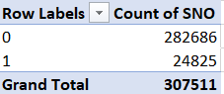
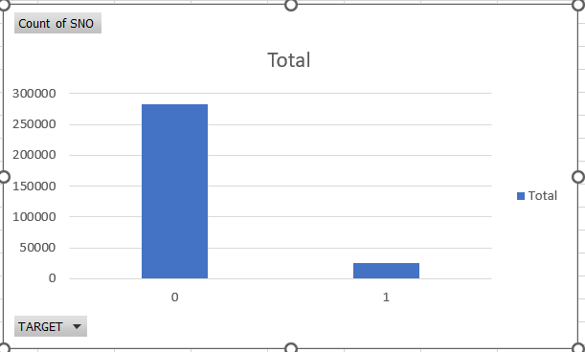
Target Variable

Slide 12
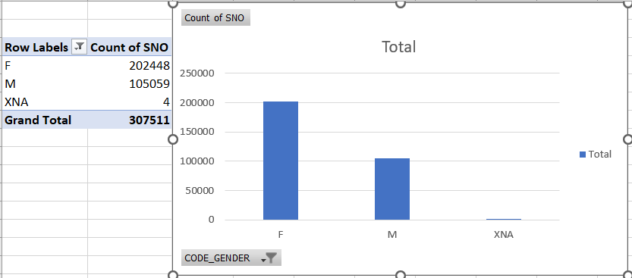
Gender Variable

Slide 13
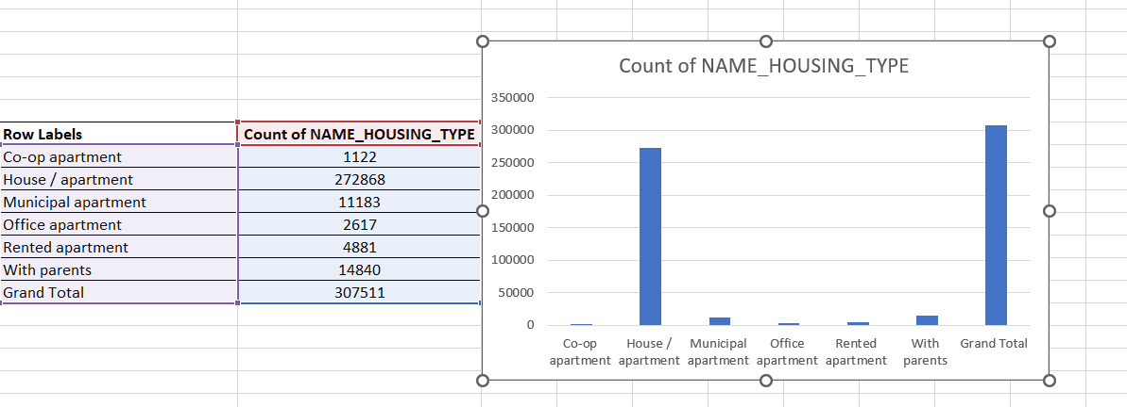
NAME_HOUSING_TYPE

Slide 14
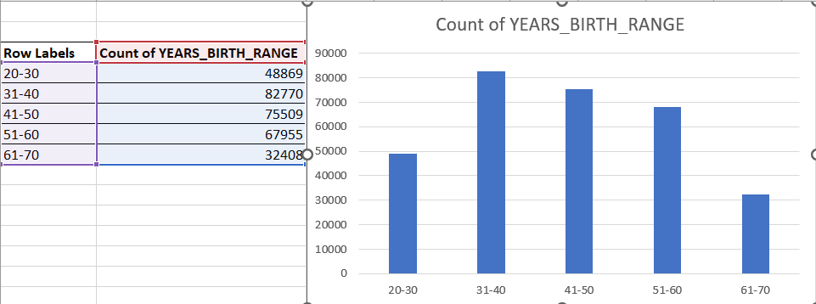
Univariant Analysis
Most of the applicants belong to the Age Group ’31-40’

Slide 15
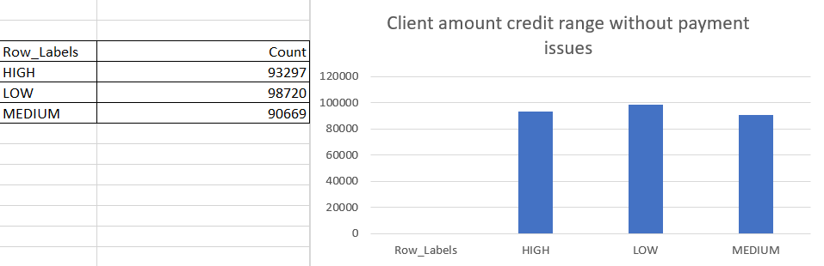
Client amount credit range

Slide 16
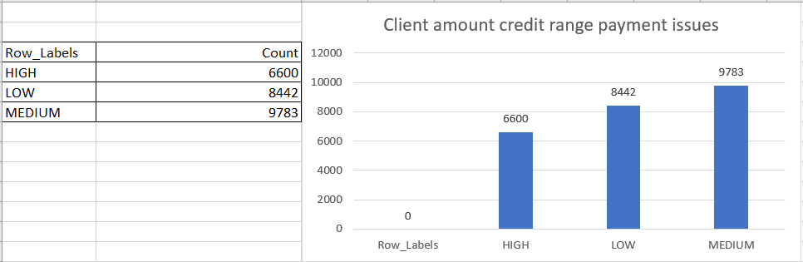
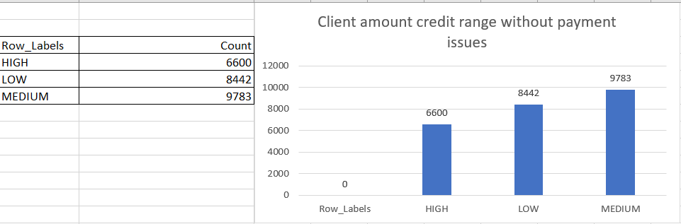
Client amount credit range payment issues

Slide 17
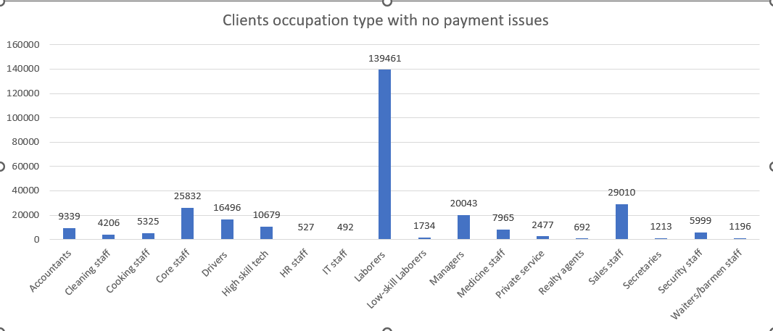
OCCUPATION_TYPE

Slide 18
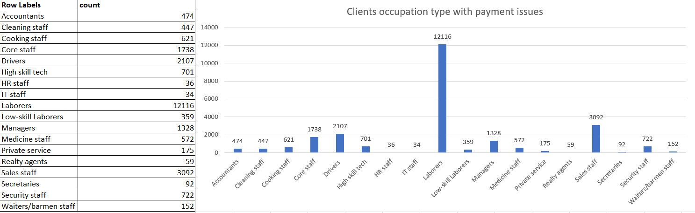

Slide 19
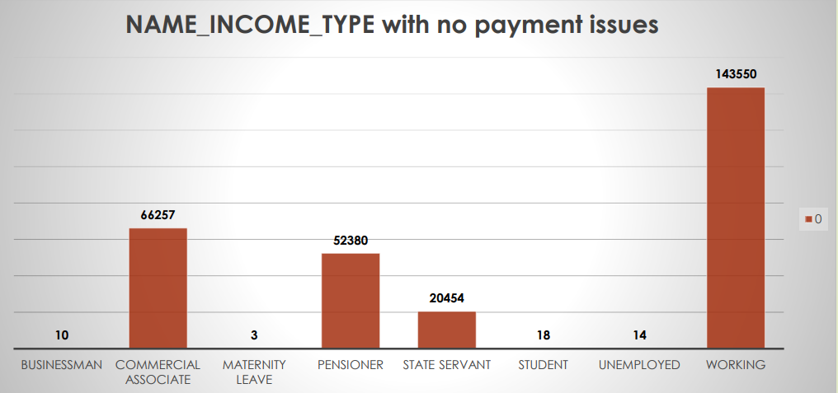
NAME_INCOME_TYPE with no payment issues

Slide 20
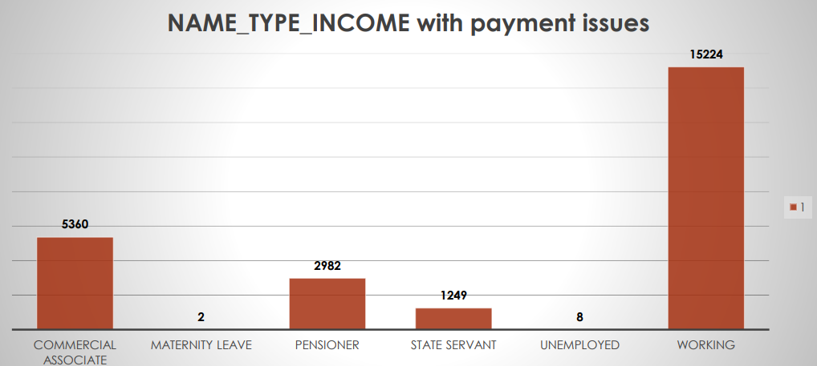
NAME_INCOME_TYPE with payment issues

Slide 21
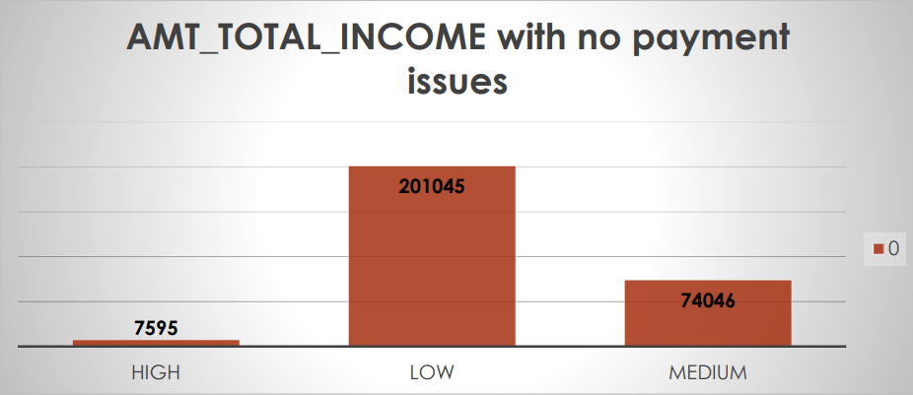
AMT_TOTAL_INCOME with no payment issues

Slide 22
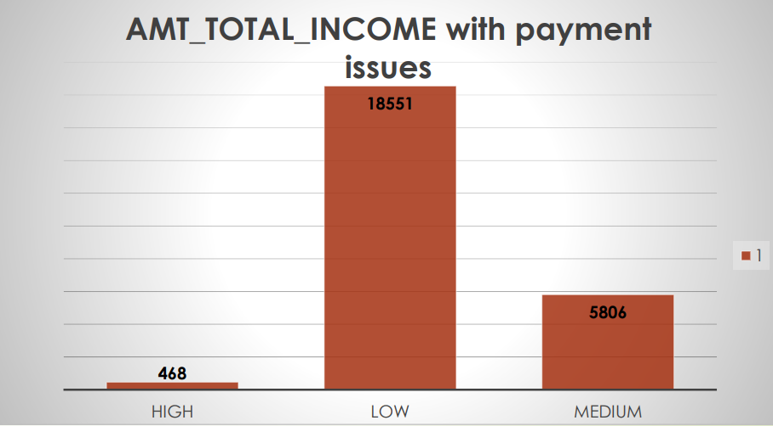
AMT_TOTAL_INCOME with payment issues

Slide 23
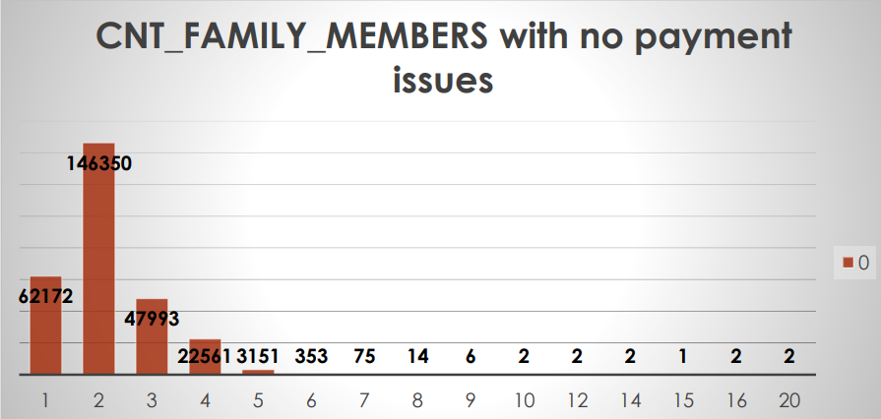
CNT_FAMILY_MEMBERS with no payment issues

Slide 24
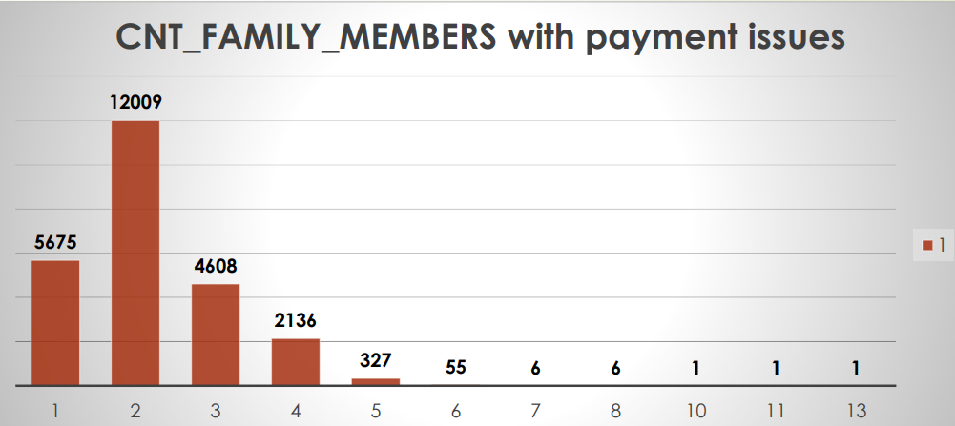
CNT_FAMILY_MEMBERS with payment issues

Slide 25
Univariate Analysis for TARGET variable

Slide 26
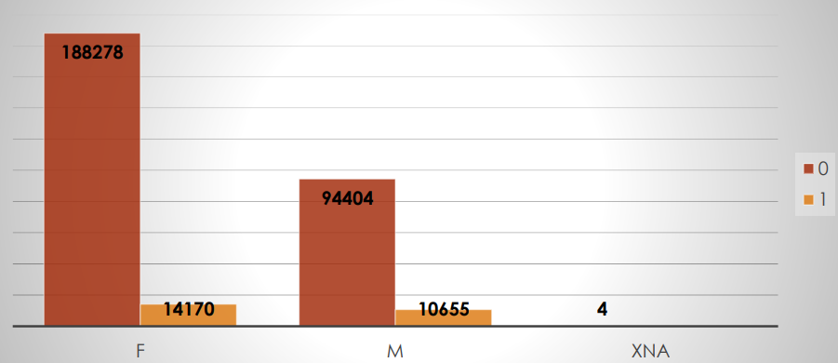
CODE_GENDER

Slide 27
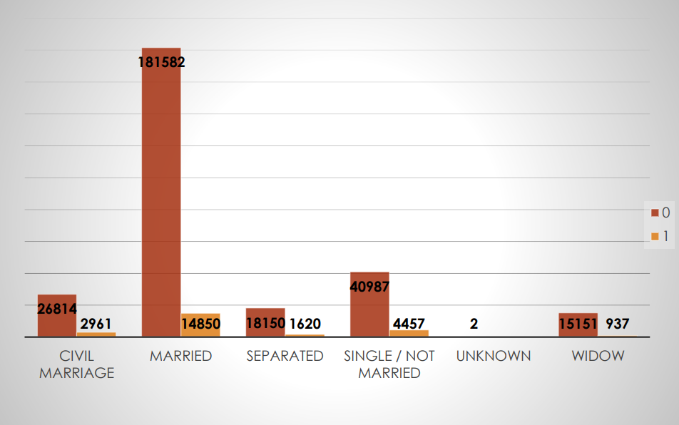
NAME_FAMILY_STATUS

Slide 28
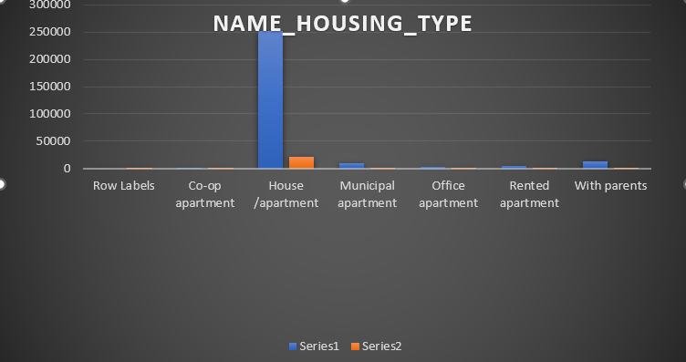
NAME_HOUSING_TYPE

Slide 29
Bivariate Analysis for TARGET variable

Slide 30
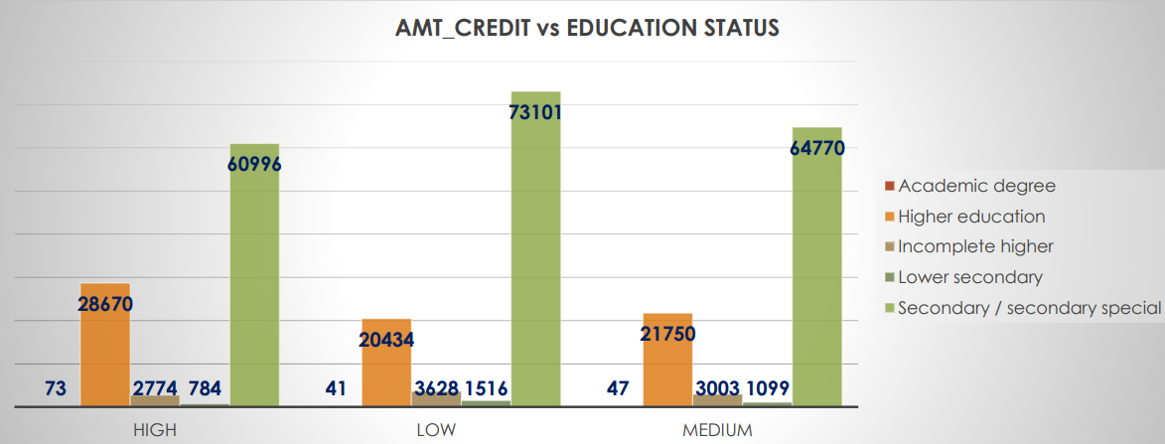
TARGET variable(0)

Slide 31
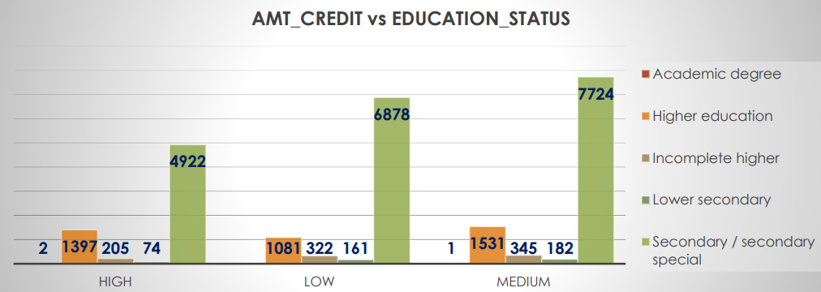
TARGET variable(1)

Slide 32
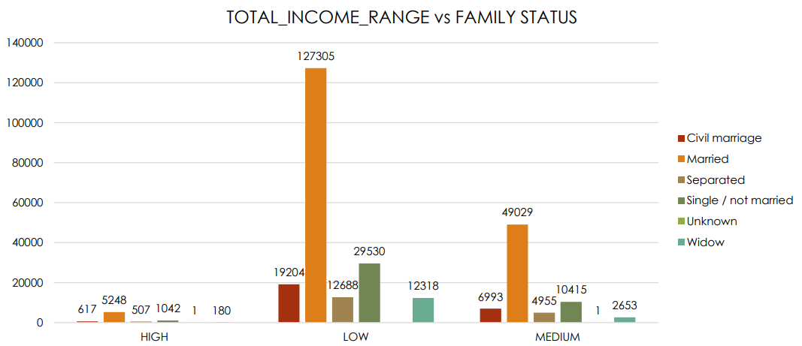
Target 0: Total Income vs Family status

Slide 33
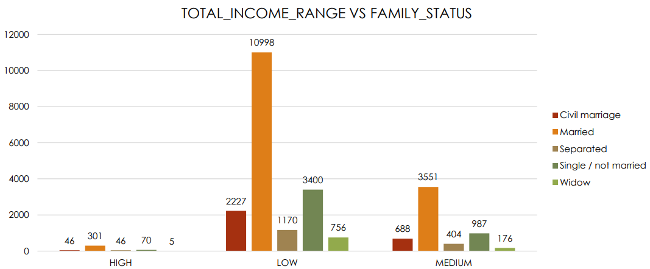
Target 1: Total Income vs Family status

Slide 34
PREVIOUS DATASET

Slide 35
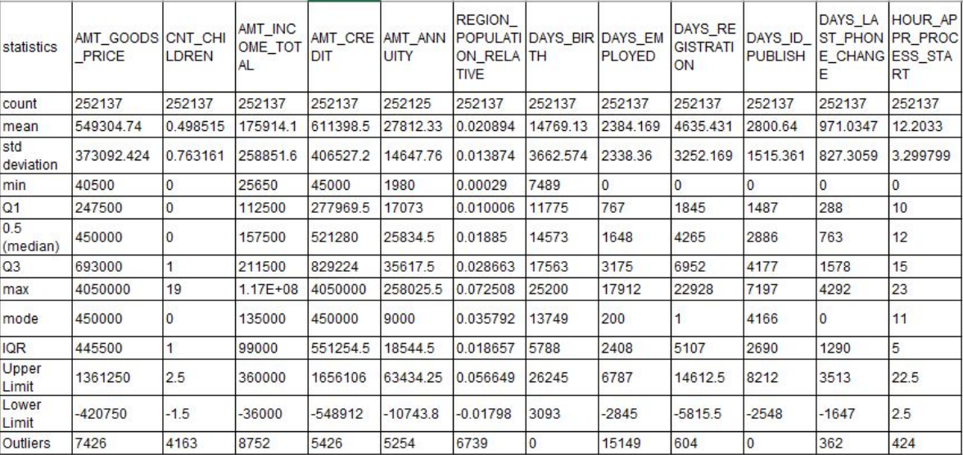

Slide 36
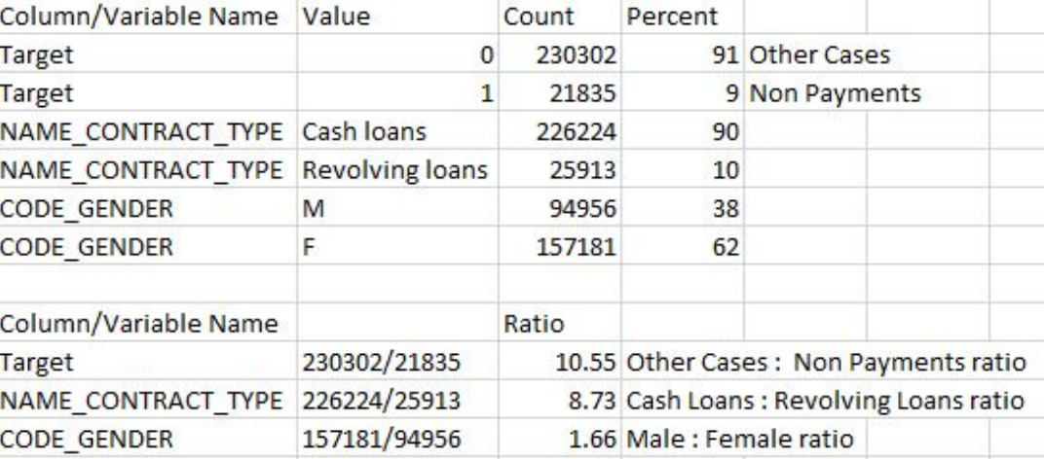
Imbalance Ratio

Slide 37
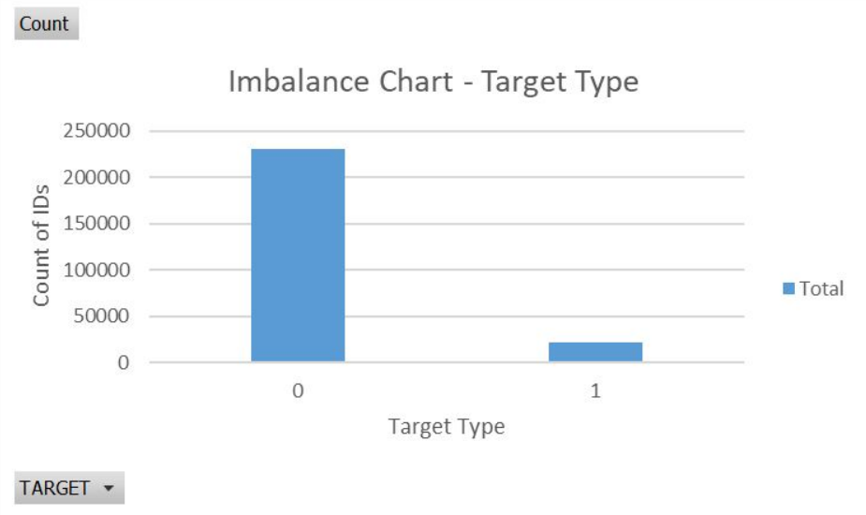

Slide 38
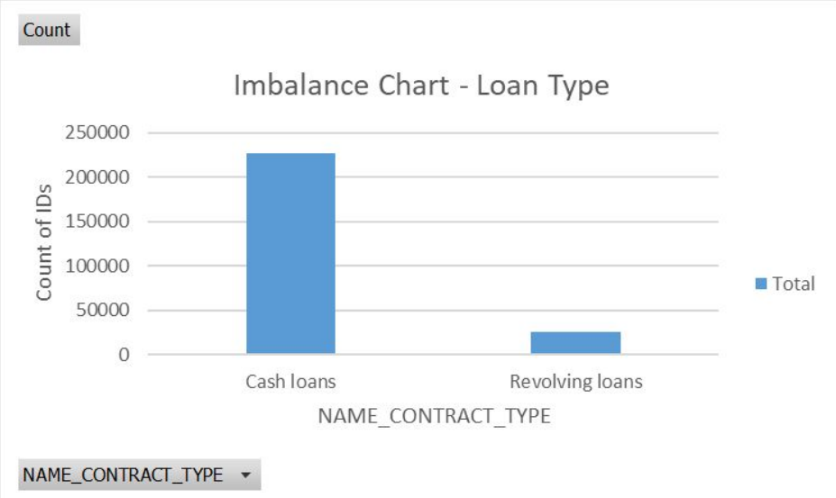

Slide 39
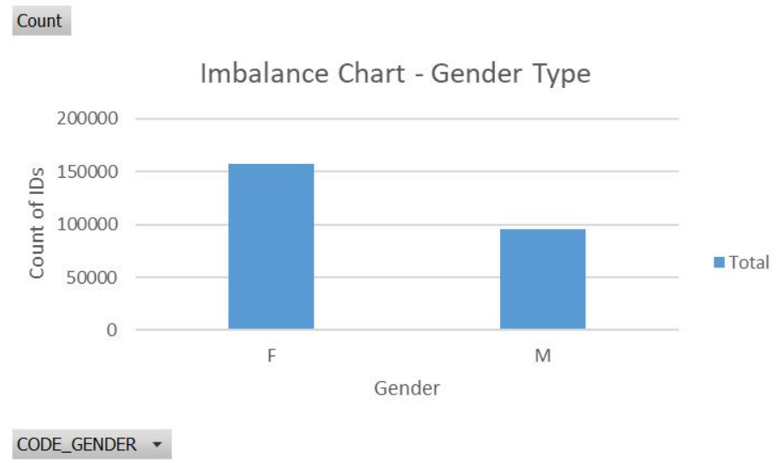

Slide 40
Univariate Analysis

Slide 41
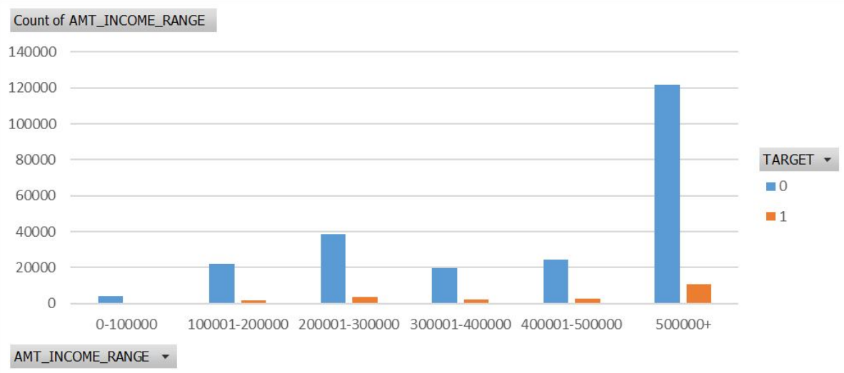

Slide 42
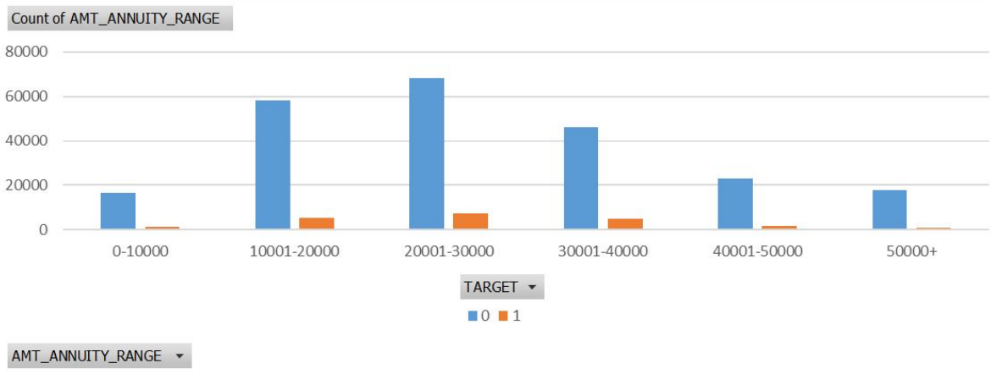

Slide 43
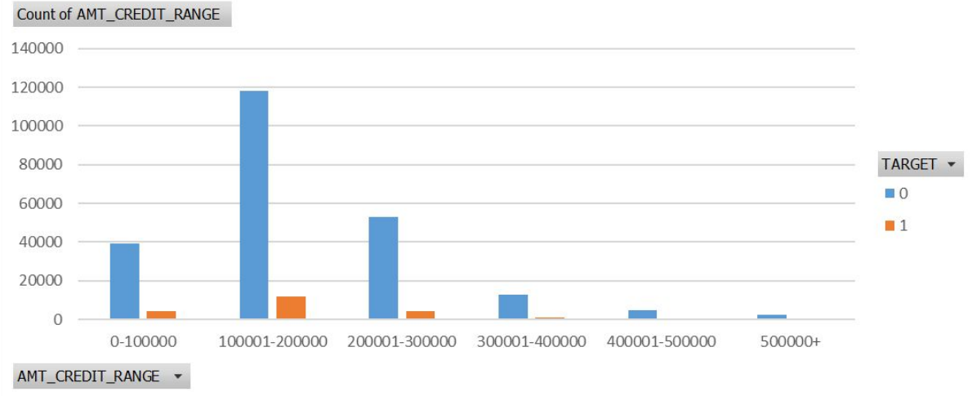

Slide 44
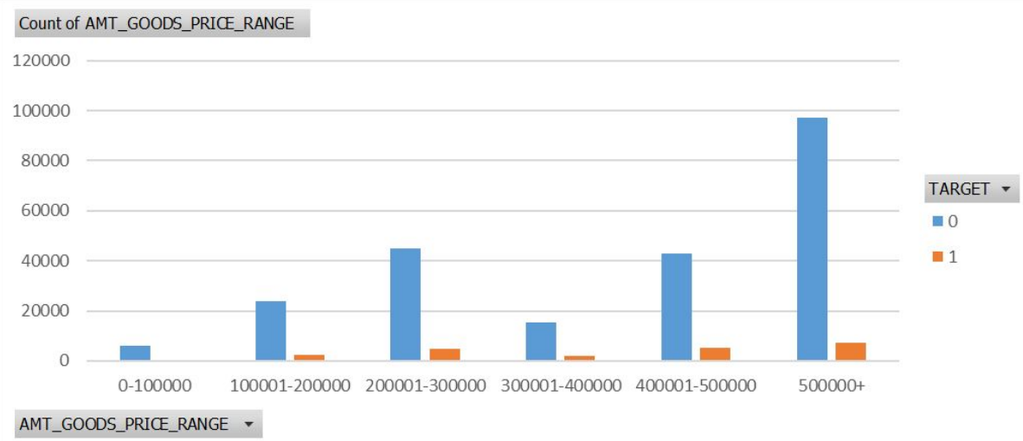

Slide 45
bivariate

Slide 46
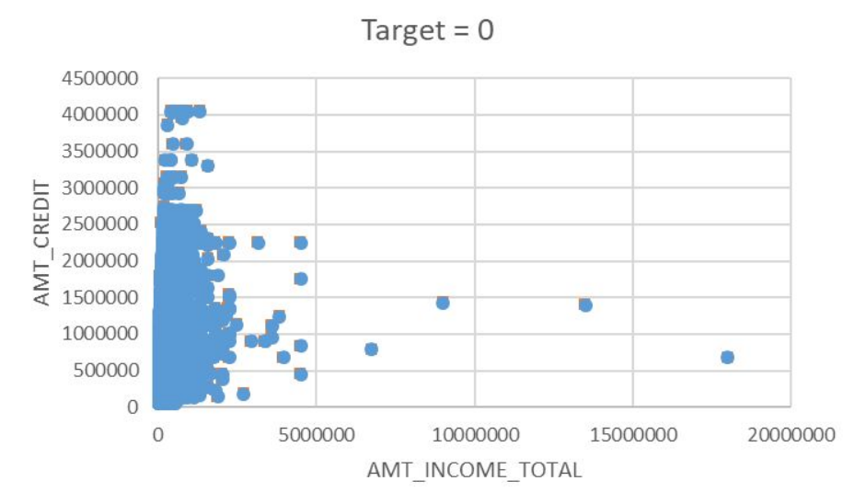
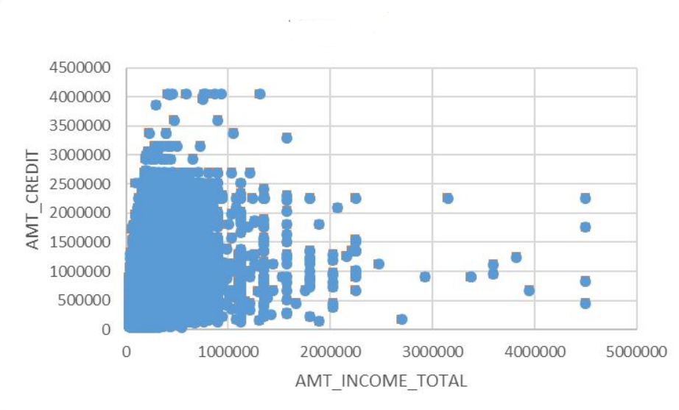
Target = 1

Slide 47
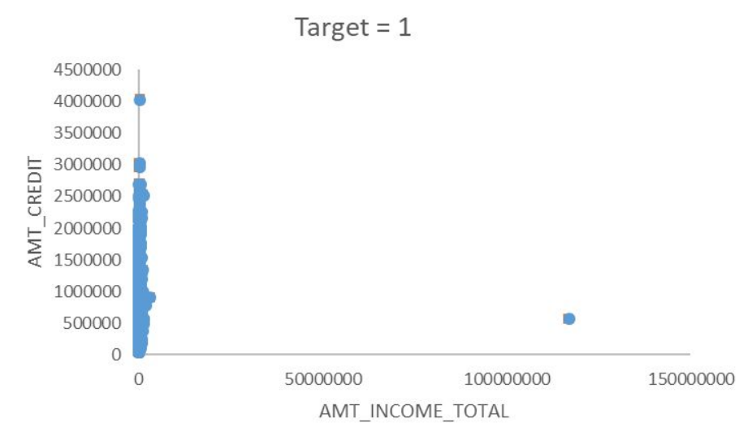
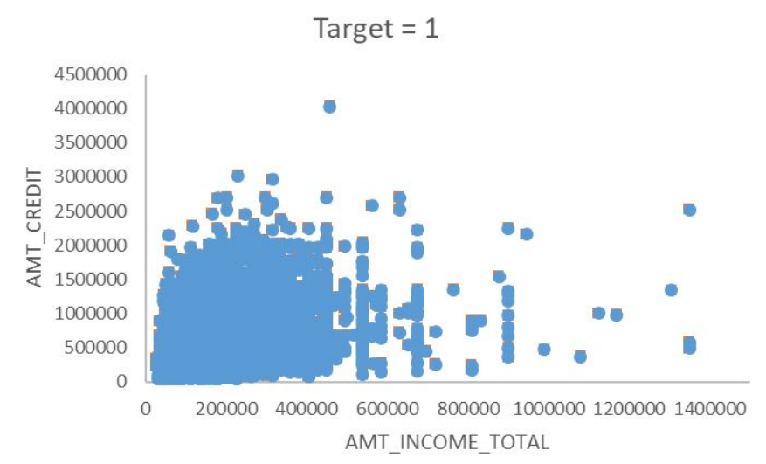

Slide 48
Correlation
Formula used - =correl(variable 1 data,variable 2 data) Correlation when Target is 0 i.e. for all other cases
Var1 ←→ Var2
AMT_CREDIT ←→ AMT_ANNUITY
AMT_ANNUITY ←→ AMT_GOODS_PRICE
LIVE_CITY_NOT_WORK_CITY ←→ REG_CITY_NOT_WORK_CITY
REG_REGION_NOT_WORK_REGION ←→ LIVE_REGION_NOT_WORK_REGION
DEF_30_CNT_SOCIAL_CIRCLE ←→ DEF_60_CNT_SOCIAL_CIRCLE
AMT_GOODS_PRICE ←→ AMT_CREDIT
OBS_30_CNT_SOCIAL_CIRCLE ←→ OBS_60_CNT_SOCIAL_CIRCLE
Above mentioned columns have Strong Positive Correlation
.

Slide 49
Correlation when Target is 1 i.e. when Payment is Unsuccessful
Var1 ←→ Var2 AMT_CREDIT ←→ AMT_ANNUITY
AMT_ANNUITY ←→ AMT_GOODS_PRICE
LIVE_CITY_NOT_WORK_CITY ←→ REG_CITY_NOT_WORK_CITY
REG_REGION_NOT_WORK_REGIO ←→ LIVE_REGION_NOT_WORK_REGION
DEF_30_CNT_SOCIAL_CIRCLE ←→ DEF_60_CNT_SOCIAL_CIRCLE
AMT_GOODS_PRICE ←→ AMT_CREDIT
OBS_30_CNT_SOCIAL_CIRCLE ←→ OBS_60_CNT_SOCIAL_CIRCLE
Above mentioned columns have Strong Positive Correlation. In the next slides, images are added which shows the correlation values of the above mentioned variables for both the cases i.e. Target 0 & 1.

Slide 50
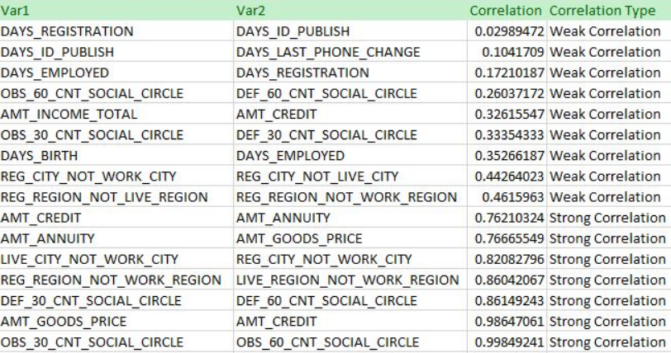
10 Correlation For Target = 0 i.e. Other Cases

Slide 51
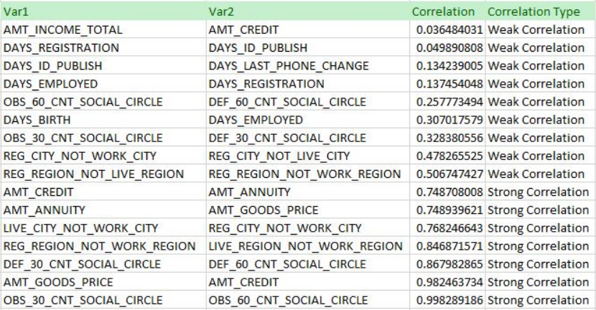
For Target = 1 i.e. Payment Issues

Slide 52
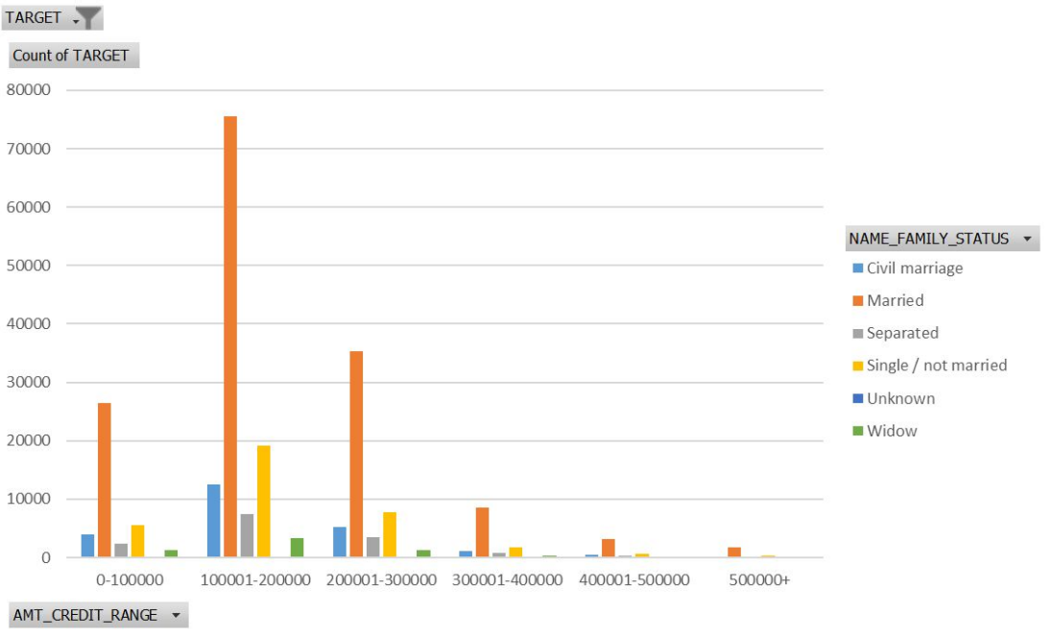
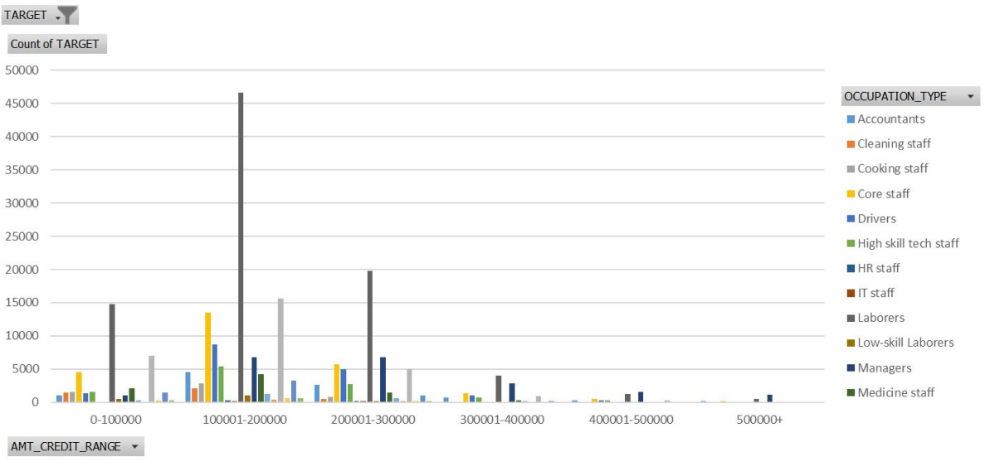
Visualizations

Slide 53
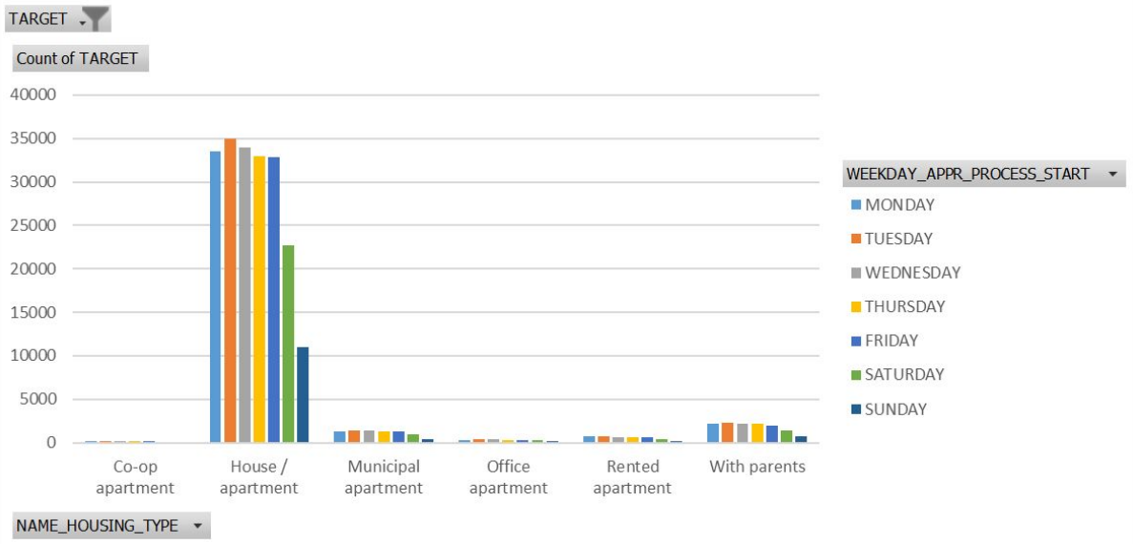
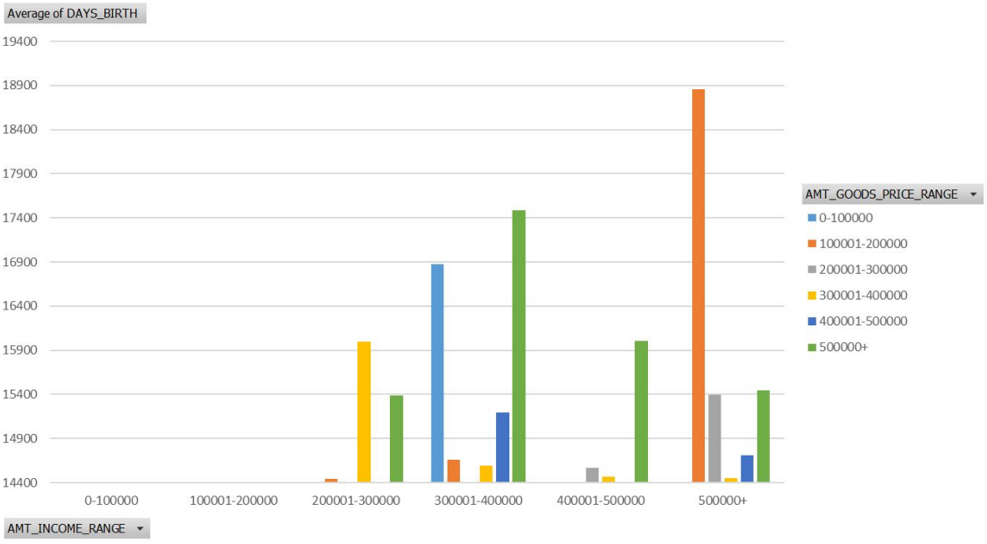
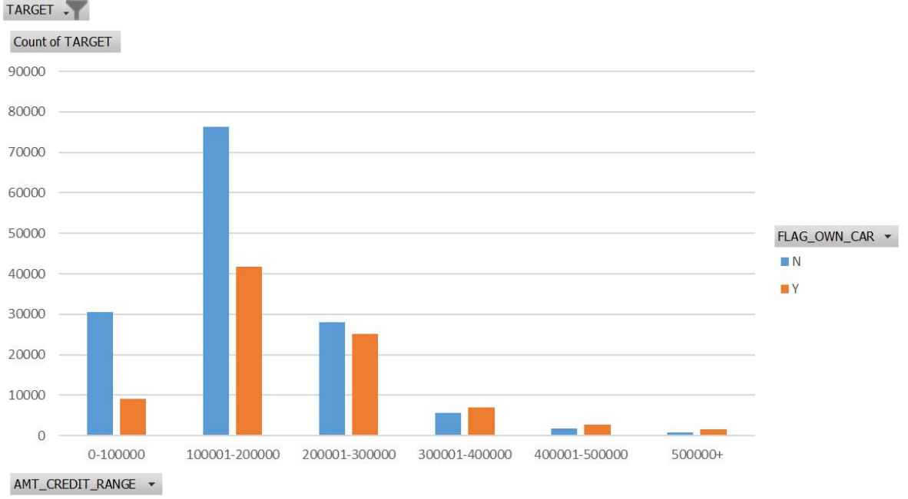
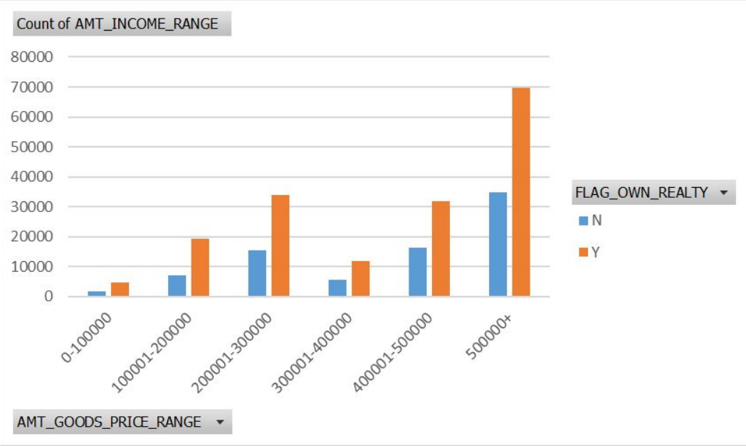

Slide 54
Conclusion
After performing the analysis, we can rectify whether a client will repay the loan or not. Also, the people who are likely to face problem in loan repayment are labourers Also, people with Secondary /secondary special education might face problem in loan repayment. Moreover, those who are living in house/apartment are facing difficulty in loan repayment (may be because of extra home loan, EMIs and so on).

